Slide 1
Program No: 1- Setting up the Arduino Development Environment.
Arduino
It is low-cost version of the popular UNO R3 Arduino.
Instead of ATmega16U2 processor, it is assembled with CH340C IC.
Simply connect it to a computer with a USB cable or power it with an AC-to-DC adapter or battery to get started.
It features the Atmega8U2 programmed as a USB-to serial converter.
The CH340 chip is an USB to Serial Converter.

Slide 2
Features of the Arduino
1. Arduino boards are able to read analog or digital input signals from different sensors and turn it into an output such as activating a motor, turning LED on/off, connect to the cloud and many other actions.
2. The board functions can be controlled by sending a set of instructions to the microcontroller on the board via Arduino IDE.
3. Arduino IDE uses a simplified version of C++, making it easier to learn to program.
4. Arduino provides a standard form factor that breaks the functions of the micro-controller into a more accessible package.

Slide 3
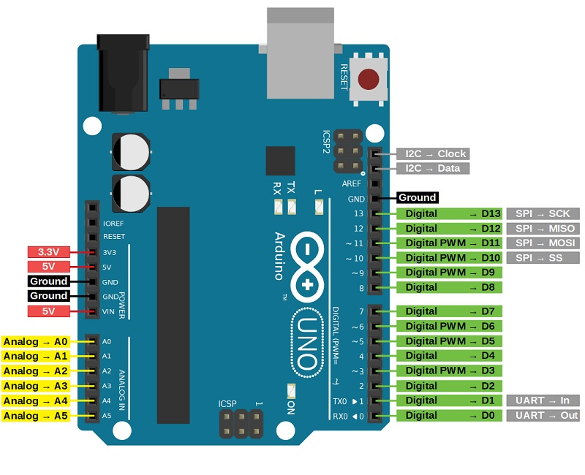

Slide 4
Vin: This is the input voltage pin of the Arduino board used to provide input supply from an external power source.
5V: This pin of the Arduino board is used as a regulated power supply voltage and it is used to give supply to the board as well as on board components.
3.3V: This pin of the board is used to provide a supply of 3.3V which is generated from a voltage regulator on the board.
GND: This pin of the board is used to ground the Arduino board.
Reset: This pin of the board is used to reset the microcontroller. It is used to Resets the microcontroller.

Slide 5
Analog Pins: The pins A0 to A5 are used as an analog input and it is in the range of 0-5V.
Digital Pins: The pins 0 to 13 are used as a digital input or output for the Arduino board.
Serial Pins: These pins are also known as a UART pin. It is used for communication between the Arduino board and a computer or other devices. The transmitter pin number 1 and receiver pin number 0 is used to transmit and receive the data resp.
External Interrupt Pins: This pin of the Arduino board is used to produce the External interrupt and it is done by pin numbers 2 and 3.
PWM Pins: This pins of the board is used to convert the digital signal into an analog by varying the width of the Pulse. The pin numbers 3,5,6,9,10 and 11 are used as a PWM pin.

Slide 6
SPI Pins: This is the Serial Peripheral Interface pin, it is used to maintain SPI communication with the help of the SPI library. SPI pins include:
1. SS: Pin number 10 is used as a Slave Select
2. MOSI: Pin number 11 is used as a Master Out Slave In
3. MISO: Pin number 12 is used as a Master In Slave Out
4. SCK: Pin number 13 is used as a Serial Clock
LED Pin: The board has an inbuilt LED using digital pin-13. The LED glows only when the digital pin becomes high.
AREF Pin: This is an analog reference pin of the Arduino board. It is used to provide a reference voltage from an external power supply.

Slide 7

Arduino IDE
The Arduino IDE (Integrated Development Environment) is essential for programming and uploading code to Arduino boards.
The Arduino IDE is needed to write, compile, and upload code to Arduino microcontrollers, enabling them to interact with sensors, actuators, and other devices.
It provides a user-friendly interface for writing, editing, and debugging programs in a simplified version of C/C++.
The IDE includes built-in libraries and tools that make it easier for beginners and professionals a like to develop projects involving electronics and microcontrollers.

Slide 8
Working of Arduino IDE
Writing Code
Sketch: The code written in the Arduino IDE is called a "sketch." It is written in a simplified version of C/C++ programming languages.
Structure: A typical sketch has two main functions:
Void setup(): This function runs once when the program starts. It's used to initialize settings, such as setting pin modes or starting serial communication.
Void loop(): This function runs repeatedly after the setup() is completed. It contains the main logic that you want to execute continuously.
Compiling Code
Verification: After writing the sketch, the IDE compiles the code to convert it into a machine-readable format.

Slide 9
Uploading Code
Serial Communication: The compiled binary code is uploaded to the Arduino board via a USB connection. This is done using the serial communication protocol.
Serial Monitor
The Arduino IDE includes a Serial Monitor, a tool that allows you to send and receive serial data from the Arduino board. It’s useful for debugging and monitoring the behavior of your sketch in real-time.

Slide 10
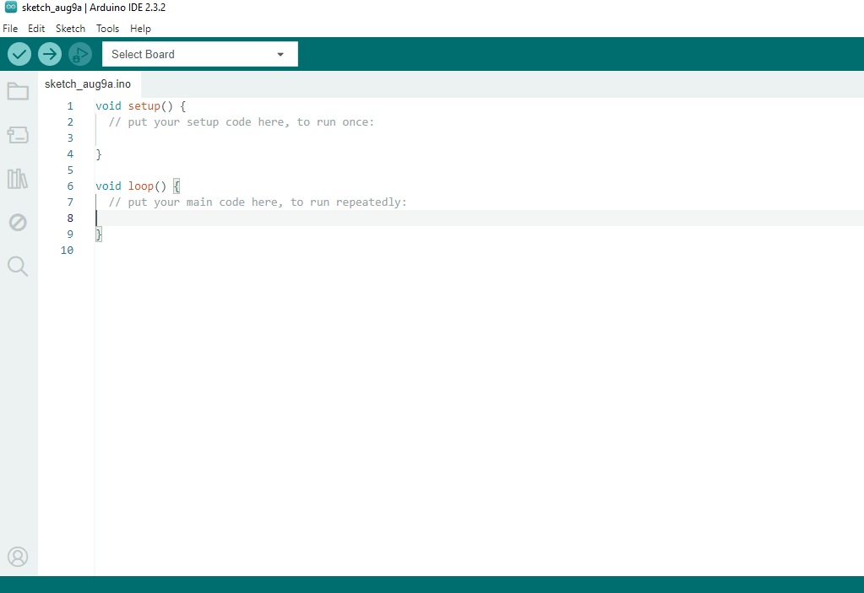
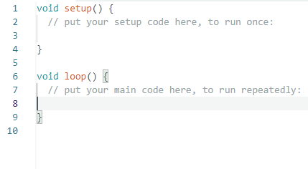
Working of Arduino IDE

